Slide 1
BEN COLWELL - 15325781

Slide 2

Overview
WHAT I’VE DONE
Developed a WebSocket analysis & tracking prevention tool.
Undertook research to see how prevalent WebSocket tracking is.
Notes:
2 main sections to my project
Developed a tool to analyse the usage of WebSockets and block any malicious purposes such as tracking/ad serving.
“Adblocker for WebSockets”
Chrome extension
Usable by anybody
Undertook research across a range of countries to explore the usage of websockets and websocket tracking

Slide 3

Why?
MOTIVATION FOR THE PROJECT
Relatively new technology
WebSocket security issues
Data security topical
Notes:
WebSockets are a relatively new innovation
Yet to be fully explored
Still have novelty
What I was doing may not have been done before
Reason for slow takeup
Security concerns
Opening live data connection between client and server poses obvious security concerns
Will discuss in detail in my report
Prone to DOS attack
CSWSH (Cross site WS highjack)
Vulnerable to input data attacks
Often used on non encrypted channels
Etc etc
Quite a topical issue
People becoming more and more aware of their online security (myself included)
Cambridge Analytica
Plain text password storing
Twitter & FB in last month

Slide 4

Implementation
HOW DID I DO IT
Notes:
As mentioned
2 main parts
User build
Then research
Briefly talk about my user build
how I implemented it and a quick demo
Then move on to take a look at some early findings in my research

Slide 5

1. User Build
WEBSOCKET ANALYSIS & TRACKING PREVENTION TOOL
Detects all WebSocket traffic
Filters first/third party
Blocks known trackers/ad servers
Hard to detect
Easy to use
Configurable
Notes:
Few key requirements
Detect all WS traffic
Filter first/third party connections
EG: FB vs. chat.FB
Block known trackers / ad servers
Secondary
Hard to detect
Wanted to build it to scale
No point if websites could easily get around it
Online security a constant race
Easy to use
Didn’t want it to be limited to technical users
But yet also wanted to give those users more fine control

Slide 6




Tools / Methods used
HOW DID I DO IT?
Chrome extension
Catching WebSocket's
Injected script
Self-destructs
Filtering WebSocket’s
Maintained tracker lists
NPM Packages
Webpack
Notes:
How did I do it?
Chrome ext / JS
2 parts:
Catching WS
Injected script
Self destruct
Filtering
Maintained tracker lists
Used by Adblock / UBlockOrigin
Maintained by a bunch of data security activists
EasyList / EasyPrivacy (most popular)
Not going to go into depth on why now.
Didn’t want to reinvent the wheel
Set it up to use NPM packages / Webpack
Pre build JS libraries for doing common tasks
Sub-domains
List syntax parsing

Slide 7
Pseudocode Algorithms
1. CATCHING WEBSOCKETS
// On every pageload
pageContent = pageContent + script;
function script = {
webSocketConstructor.prototype = function myWebSocketConstructor(){
// Do what we want with WebSocket object here.
// E.g: Attach listeners for incoming messages
webSocketConstructor();
}
}
script.onLoad(this.delete);
Notes:
Algorithm for catching WS
Discuss

Slide 8
Pseudocode Algorithms
2. FILTERING WEBSOCKETS
if(websocketURL.domain = webpageURL.domain)
{
firstParty = true;
}
if(firstParty)
{
checkAgainstLists(websocketURL);
if(hitFilterLists) closeWebsocket() || dropConnection();
}
Notes:
Extremely simplified version of filtering algorithm
Better understand whats going on under the hood
Dropping connection helps stop sites fighting against it

Slide 9
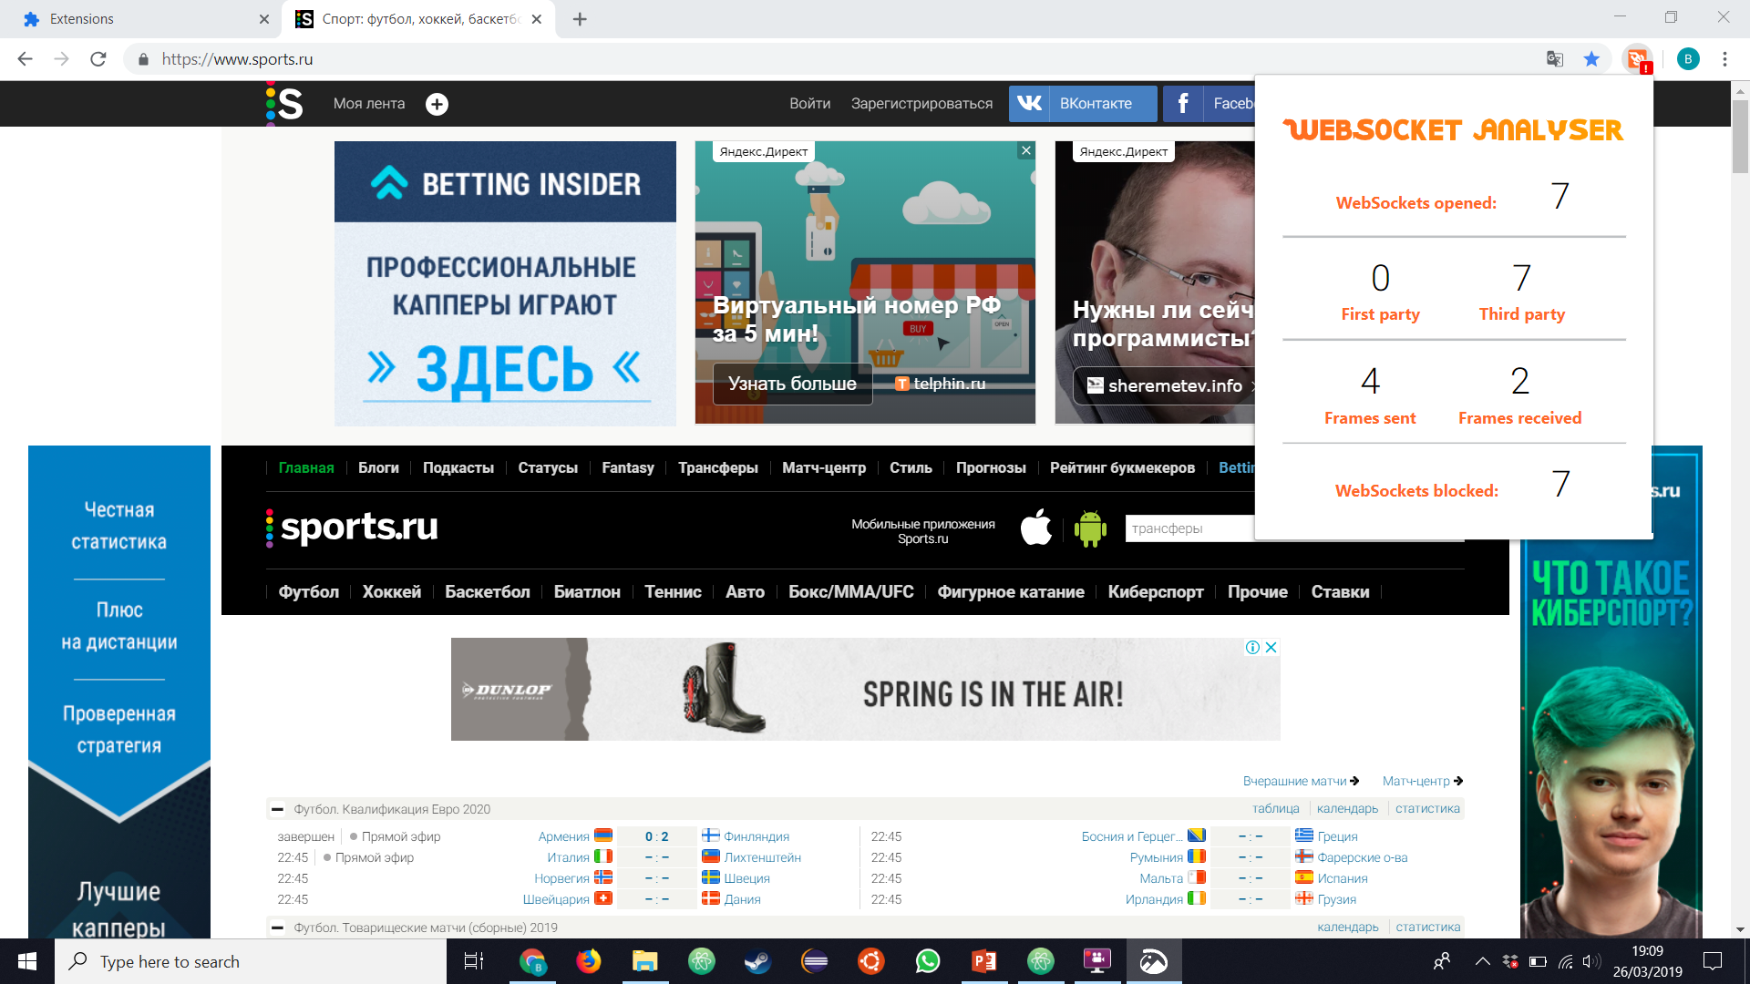
Live Demo
(WITH EMERGENCY VIDEO BACKUP)
Notes:
Going to try do this live

Slide 10
2. Research
INVESTIGATION INTO WEBSOCKET USAGE
Frequency of WebSocket usage
First / Third party
Used for tracking/ad serving?
Region comparison
Is this a problem?
Notes:
Second part
Few key points I was particularly interested in
Talk around bullets
Region comparison -> Preconceived ideas that certain countries would be worse (Russia)
Is this a problem? Short answer is “Not yet”

Slide 11









Method
HOW I WENT ABOUT MY RESEARCH
Puppeteer
Alexa
6 Countries
Notes:
Used puppeteer (explain)
Headless browser (scripted robot)
Loaded with a stripped down version of my extension
Alexa lists
Amazon owned company
Provides lists of the most popular sites by country
6 Countries: discuss
Details I settled on:
1 min per site
Only filtered TP WS

Slide 12
Results
From surveying 600 popular sites across 6 countries.
OVERALL
41 | sites opened WebSocket’s
133 | WebSocket’s opened
76% | third party
39% | hit filter list
Notes:
Caveat: Preliminary look (data may be +- a small bit). Need to have detailed look through data.
41 sites / 600 is not massive – not been huge takeup as of yet (slightly limited data set)
133 – avg of 3.25 WS per site
Interesting as live data stream so transfers are either huge or sites not well written
76% – Shocked myself and Doug
39% hit the filter list, about 1/2!
Only 3 sites. (of 600 = 0.5%)

Slide 13
Results – WebSocket usage
Ireland has the highest number of sites that use WebSockets
From surveying 600 popular sites across 6 countries.
SITES THAT USE WEB SOCKETS
Notes:
Shockingly to me Ireland was the significant leader in the number of sites

Slide 14
Results – Third party WebSockets
Russia has the lowest proportion of third party WebSockets
From surveying 600 popular sites across 6 countries.
% THIRD PARTY WEBSOCKETS
Notes:
Huge tendency towards third party WS
Personally found it shocking how low Russia was here, especially compared to Ireland.
I would have guessed the first and last three would be swapped.

Slide 15
Results – Websockets hit filter USA Has highest proportion of WebSocket's which hit filter lists
From surveying 600 popular sites across 6 countries.
% WEBSOCKETS WHICH HIT FILTER
Notes:
Of these third party sockets
USA significantly higher.
Russia low again
Two theories
My tool isn’t as accurate as I think (Unlikely ;) )
No need to use WS as limited data security for gen pop in Russia
Can take the same data via simpler means (HTTP etc)
Important note: What were looking at – WS tracking/ad serving – not overall

Slide 16

Room for improvement
WHAT ELSE COULD BE DONE?
Not allowing WebSockets to open
Further data analysis
Wider data capture
WebSocket caching
Notes:
Not allowing
Speed implications
Vast majority of WS connection legitimate and fine
Would slow down browsing significantly
Currently block almost all, after three hours of testing I let 3 frames through.
IF a site caught on then they could exploit this.

Slide 17

Thank you! Questions?
Ben Colwell
0867377087
bcolwell@tcd.ie

